Slide 1

UML DIAGRAMS

Slide 2
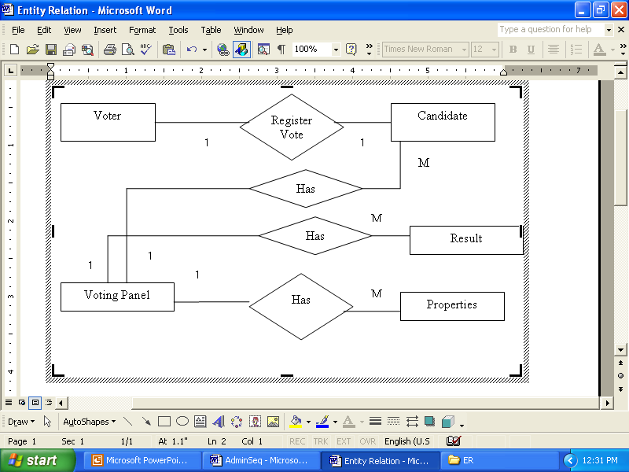
Entity RelationShip

Slide 3
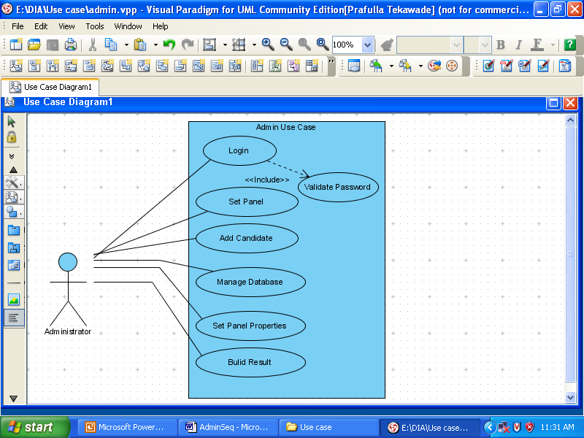
Admin Use Case.

Slide 4
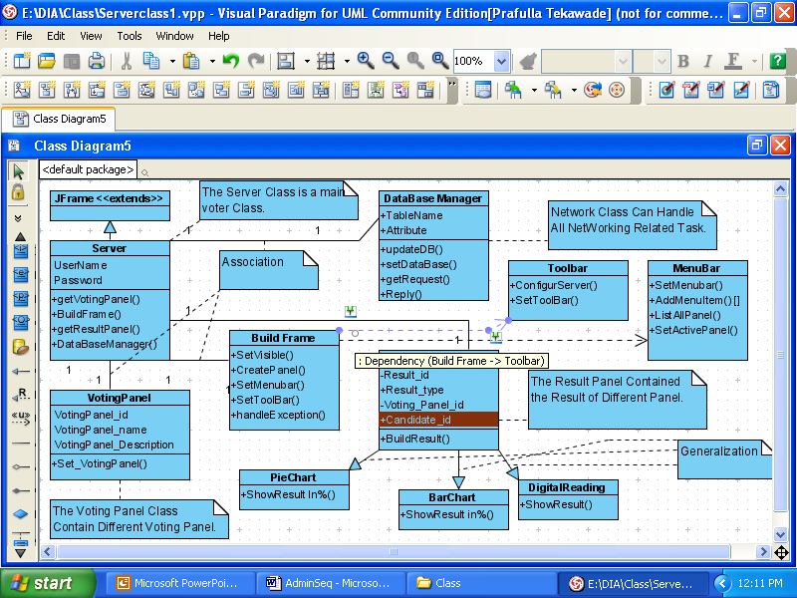
Admin Class Diagram

Slide 5
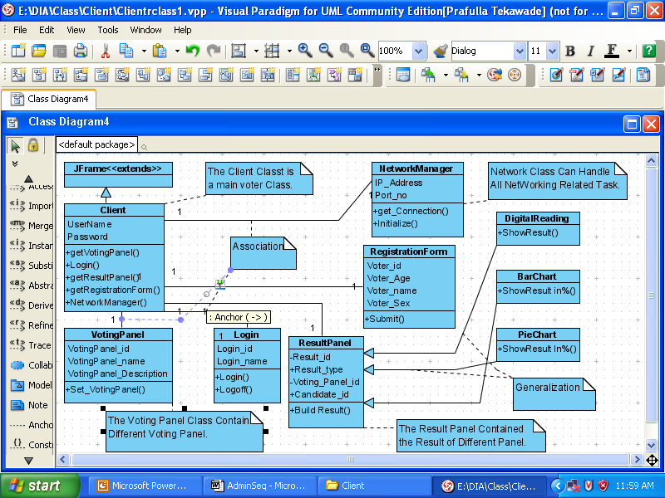
Voter Class Diagram.

Slide 6
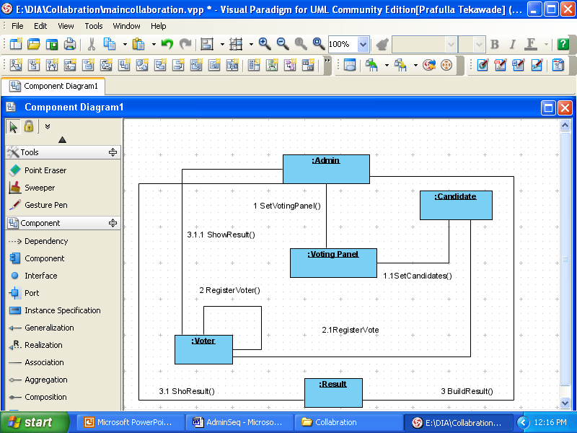
Main Collaboration

Slide 7
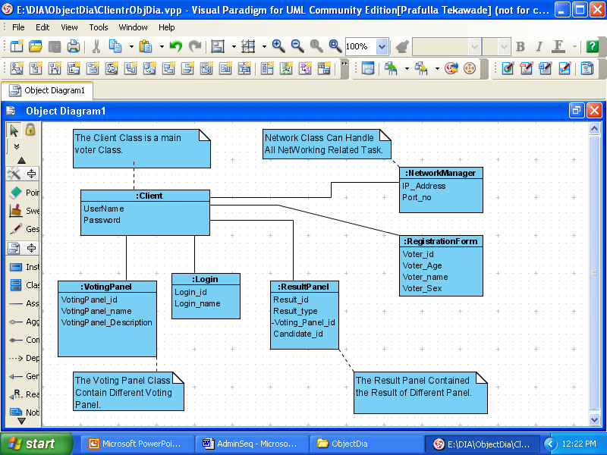
Voter Object Diagram

